Slide 1
PROCESS MANAGEMENT

Slide 2
LECTURE OBJECTIVES
To introduce the concept of a process—a program in execution, which forms the basis of all computation.
To describe the various features of processes, including scheduling, creation, and termination.
To explore inter process communication using shared memory and message passing.
To describe communication in client–server systems.

Slide 3
PROCESS CONCEPT
WHAT IS A PROCESS?
Informally a program in the execution is called a Process. Process is not the same as program. A process is more than a program code.
A process is an 'active' entity as opposed to program which is considered to be a 'passive' entity.
Attributes held by process include hardware state, memory, CPU etc.

Slide 4
Process memory is divided into four sections for efficient working :
The text section is made up of the compiled program code, read in from non-volatile storage when the program is launched.
The data section is made up the global and static variables, allocated and initialized prior to executing the main.
The heap is used for the dynamic memory allocation, and is managed via calls to new, delete, malloc, free, etc.
The stack is used for local variables. Space on the stack is reserved for local variables when they are declared.

Slide 5
Process diagram
Stack
Heap
Data
Text

Slide 6
Process control block (PCB)
This is a data structure an operating system will create for each process.
One program can be several processes. Like is if you open a browser many times . Each will have its own PCB with different resources .
Some of the information contained in the PCB:

Slide 7
Process control block (PCB) cont’d
Process State - It can be running, waiting etc.
Process ID and parent process ID.
CPU registers and Program Counter. Program Counter holds the address of the next instruction to be executed for that process.
CPU Scheduling information - Such as priority information and pointers to scheduling queues.
Memory Management information - Eg. page tables or segment tables.
Accounting information - user and kernel CPU time consumed, account numbers, limits, etc.
I/O Status information - Devices allocated, open file tables, etc.

Slide 8
PROCESS STATE
Processes can be any of the following states :
New. The process is being created.
Ready. The process is waiting to be assigned to a processor.
Running. Instructions are being executed.
Waiting. The process is waiting for some event to occur (such as an I/O completion or reception of a signal).
Terminated. The process has finished execution.

Slide 9
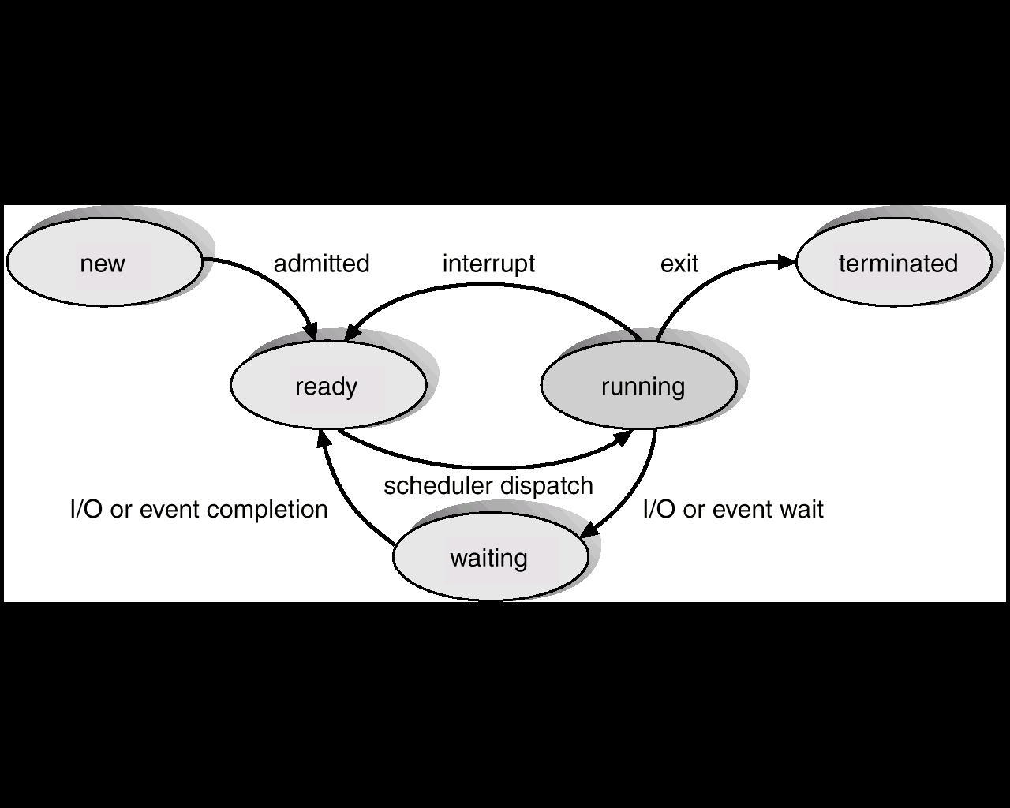

Slide 10
Threads
The process model discussed so far has implied that a process is a program that performs a single thread of execution.
This single thread of control allows the process to perform only one task at a time. The user cannot simultaneously type in characters and run the spell Checker within the same process, for example.
Most modern operating systems have extended the process concept to allow a process to have multiple threads of execution and thus to perform more than one task at a time.
On a system that supports threads, the PCB is expanded to include information for each thread.

Slide 11
Process Scheduling
The act of determining which process in the ready state should be moved to the running state is known as Process Scheduling.
The prime aim of the process scheduling system is to keep the CPU busy all the time and to deliver minimum response time for all programs.
For achieving this, the scheduler must apply appropriate rules for swapping processes IN and OUT of CPU.

Slide 12
Process Scheduling
The objective of multiprogramming is to have some process running at all times, to maximize CPU utilization.
The objective of time sharing is to switch the CPU among processes so frequently that users can interact with each program while it is running.
For a uniprocessor system, there will never be more than one running process.
If there are more processes, the rest will have to wait until the CPU is free and can be rescheduled.

Slide 13
Process Scheduling cont’d
Schedulers fall into one of the two general categories :
Non pre-emptive scheduling. When the currently executing process gives up the CPU voluntarily.
Pre-emptive scheduling. When the operating system decides to favor another process, pre-empting the currently executing process.

Slide 14
Scheduling Queues
System queues
Job queue: Set of all processes in the system
Ready queue: Set of all processes in the main memory ready and waiting to execute.
Device queues: Set of processes waiting for an I/O device to become available .

Slide 15
Types of Schedulers
There are three types of schedulers available :
Long Term Scheduler : not invoked frequently. Decides which program must get into the job queue. From the job queue, the Job Processor, selects processes and loads them into the memory for execution. Primary aim of the Job Scheduler is to maintain a good degree of Multiprogramming.
Short Term Scheduler : This is also known as CPU Scheduler and runs very frequently. The primary aim of this scheduler is to enhance CPU performance and increase process execution rate.
Medium Term Scheduler : During extra load, this scheduler picks out big processes from the ready queue for some time, to allow smaller processes to execute, thereby reducing the number of processes in the ready queue. It also does swapping .

Slide 16
Scheduler cont’d
It is important that the long-term scheduler make a careful selection. In general, most processes can be described as either I/O bound or CPU bound.
I/O-bound process – spends more time doing I/O than computations, many short CPU bursts.
CPU-bound process – spends more time doing computations; few very long CPU bursts.

Slide 17
Context switch
Switching the CPU to another process requires saving the state of the old process and loading the saved state for the new process. This task is known as a context switch.
The context of a process is represented in the PCB of a process; it includes the value of the CPU registers, the process state, and memory- management information.

Slide 18
Context switch cont’d
When a context switch occurs, the kernel saves the context of the old process in its PCB and loads the saved context of the new process scheduled to run.
Context-switch time is pure overhead, because the system does no useful work while switching. Switching speed varies from machine to machine, depending on the memory speed, the number of registers that must be copied, and the existence of special instructions.

Slide 19
Process Creation
Through appropriate system calls, such as fork or spawn, processes may create other processes. The process which creates other process, is termed the parent of the other process, while the created sub-process is termed its child.
Each process is given an integer identifier, termed as process identifier, or PID. The parent PID (PPID) is also stored for each process.
On a typical UNIX systems the process scheduler is termed as sched, and is given PID 0. The first thing done by it at system start-up time is to launch init, which gives that process PID 1. Further Init launches all the system daemons and user logins, and becomes the ultimate parent of all other processes.

Slide 20
Daemon
A daemon is a long-running background process that answers requests for services. It does not require interaction with user.
The term originated with Unix, but most operating systems use daemons in some form or another.
In Unix, the names of daemons conventionally end in "d".
Some examples include inetd, httpd, nfsd, sshd, named, and lpd.

Slide 21
Process Creation cont’d
A child process may receive some amount of shared resources with its parent depending on system implementation.
To prevent runaway children from consuming all of a certain system resource, child processes may or may not be limited to a subset of the resources originally allocated to the parent.

Slide 22
Options for parent process
There are two options for the parent process after creating the child :
Wait for the child process to terminate before proceeding. Parent process makes a wait() system call. UNIX shells normally wait for their children to complete before issuing a new prompt.
Run concurrently with the child, continuing to process without waiting.

Slide 23
Process Termination
By making the exit(system call), typically returning an int, processes may request their own termination.
This int is passed along to the parent if it is doing a wait(), and is typically zero on successful completion and some non-zero code in the event of any problem.
Notes:
Voluntary or involuntarily

Slide 24
Reasons why processes are terminated.
The inability of the system to deliver the necessary system resources.
In response to a KILL command or other unhandled process interrupts.
A parent may kill its children if the task assigned to them is no longer needed i.e. if the need of having a child terminates.
If the parent exits, the system may or may not allow the child to continue without a parent .

Slide 25
Process Termination cont’d
When a process ends, all of its system resources are freed up, open files flushed and closed, etc.
The process termination status and execution times are returned to the parent if the parent is waiting for the child to terminate, or eventually returned to init if the process already became an orphan.
The processes which are trying to terminate but cannot do so because their parent is not waiting for them are termed zombies.
These are eventually inherited by init as orphans and killed off.

Slide 26
Inter process Communication
Processes executing concurrently in the operating system may be either independent or cooperating processes.
A process is independent if it cannot affect or be affected by the other processes executing in the system.
A process is cooperating if it can affect or be affected by the other processes executing in the system.
Clearly, any process that shares data with other processes is a cooperating process.

Slide 27
Inter-process Communication
There are several reasons for providing an environment that allows process cooperation:
Information sharing.
Computation speedup. If we want a particular task to run faster, we must break it into subtasks, each of which will be executing in parallel with the others.
Modularity. We may want to construct the system in a modular fashion, dividing the system functions into separate processes or threads.
Convenience. Even an individual user may work on many tasks at the same time. For instance, a user may be editing, listening to music, and compiling in parallel.

Slide 28
Interprocess Communication
Cooperating processes require an interprocess communication (IPC) mechanism that will allow them to exchange data and information. There are two fundamental models of interprocess communication: shared memory and message passing.
In the shared-memory model, a region of memory that is shared by cooperating processes is established. Processes can then exchange information by reading and writing data to the shared region.
In the message-passing model, communication takes place by means of messages exchanged between the cooperating processes.

Slide 29
Shared-Memory Systems
Interprocess communication using shared memory requires communicating processes to establish a region of shared memory. Typically, a shared-memory region resides in the address space of the process creating the shared-memory segment.
Other processes that wish to communicate using this shared-memory segment must attach it to their address space. Recall that, normally, the operating system tries to prevent one process from accessing another process’s memory. Shared memory requires that two or more processes agree to remove this restriction.

Slide 30
Message-Passing Systems
Another way to achieve the same effect is for the operating system to provide the means for cooperating processes to communicate with each other via a message-passing facility.
Message passing provides a mechanism to allow processes to communicate and to synchronize their actions without sharing the same address space. It is particularly useful in a distributed environment, where the communicating processes may reside on different computers connected by a network. For example, an Internet chat program could be designed so that chat participants communicate with one another by exchanging messages.

Slide 31
Communication in Client–Server Systems
Sockets
A socket is defined as an endpoint for communication. A pair of processes communicating over a network employs a pair of sockets—one for each process. A socket is identified by an IP address concatenated with a port number.
The server waits for incoming client requests by listening to a specified port. Once a request is received, the server accepts a connection from the client socket to complete the connection. Servers implementing specific services listen to well-known ports (a telnet server listens to port 23; an FTP server listens to port 21; and a web, or HTTP, server listens to port 80). All ports below 1024 are considered well known.

Slide 32
Communication in Client–Server Systems
When a client process initiates a request for a connection, it is assigned a port by its host computer. This port has some arbitrary number greater than 1024.
For example, if a client on host X with IP address 146.86.5.20 wishes to establish a connection with a web server (which is listening on port 80) at address 161.25.19.8, host X may be assigned port 1625.
The connection will consist of a pair of sockets: (146.86.5.20:1625) on host X and (161.25.19.8:80) on the web server.
The packets traveling between the hosts are delivered to the appropriate process based on the destination port number.

Slide 33
Communication in Client–Server Systems
A client communicates with the server by creating a socket and connecting to the port on which the server is listening.
The client creates a Socket and requests a connection with the server at IP address 127.0.0.1 on port 6013.
Once the connection is made, the client can read from the socket using normal stream I/O statements.

